Slide 1


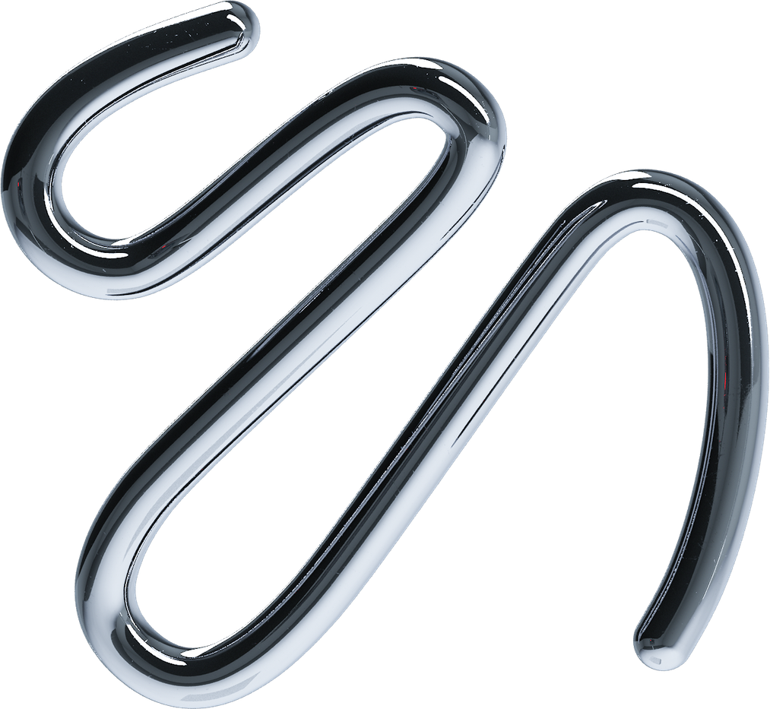


ARCs
Spoly
AI-Powered Notes &
Diagram Generator
Learn Now!
Ashish Chaurasiya - 12
Aniket Dhoke - 17
Vedant Dhotre - 18

Slide 2


Problem Statement
The Bottleneck: Processing audio from long lectures or meetings is highly time-consuming because users must listen to the entire recording just to extract key points.
The Goal: To design and develop an automated system consisting of a browser extension and a full-stack web application that rapidly converts speech to text and generates concise summaries.
The Impact: This ensures important information is extracted, structured, and understood quickly and efficiently, eliminating the inefficiencies of manual note-taking.

Slide 3
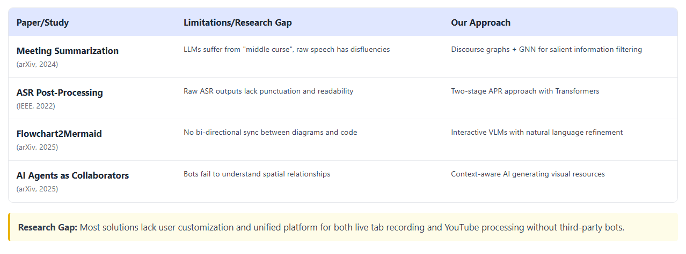
Wardiere Inc.
Home
About Us
Wardiere Inc.
Contact
Literature Survey
Current Landscape:
Existing solutions accurately generate transcripts and structured text using models like OpenAI Whisper.
The Research Gap:
Current platforms lack the native capabilities to generate complex visual diagrams (like flowcharts or architecture maps) directly from contextual audio.
Processing Limitations:
Raw Automatic Speech Recognition (ASR) pipelines often produce unreadable text without punctuation, and existing meeting bots fail to dynamically generate visual aids during the flow of a meeting.

Slide 4

Wardiere Inc.
Home
About Us
Wardiere Inc.
Contact
Proposed Design
Client Extension:
A Chrome extension utilizing Manifest V3 captures active tab audio streams.
Frontend Client:
The UI handles live audio capture, real-time user interactions, and renders Mermaid diagrams.
API Gateway & Backend:
A FastAPI server orchestrates the data pipeline between the frontend, the database, and the AI services.
Database & Auth:
MongoDB efficiently stores user profiles, historical transcripts, generated summaries, and diagram states, while Clerk securely handles user authentication via webhooks.

Slide 5
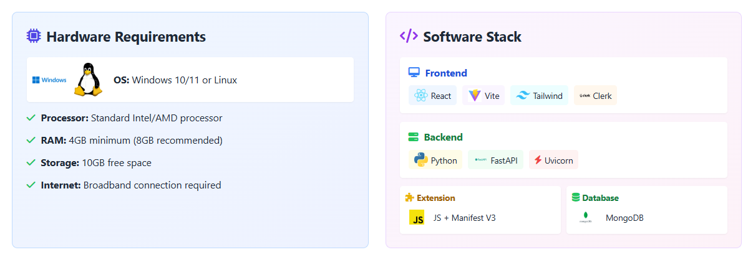
Wardiere Inc.
Home
About Us
Wardiere Inc.
Contact
Hardware and Software Requirements
Hardware: Standard Windows or Linux environment with internet connectivity.
Frontend: React (JSX), Vite, Tailwind CSS, Redux Toolkit, and Clerk-React.
Backend: Python, FastAPI, Uvicorn, PyMongo, and SVIX.
Browser Extension: JavaScript, Chrome Manifest V3.
Database: MongoDB.

Slide 6
Wardiere Inc.
Home
About Us
Wardiere Inc.
Contact
Implementation Methodology
Data Capture: Audio is ingested via device microphone, file uploads, or YouTube links.
Phase 1 - Audio Processing: Utilizes the OpenAI Whisper model to accurately convert multilingual audio streams into raw text.
Phase 2 - Intelligence Layer: A custom-trained model processes the raw text to translate, summarize, and format structural logic flawlessly.
  Training Technique: Low-Rank Adaptation (LoRA) was used for fine-tuning. This technique injects small trainable matrices into transformer layers, drastically reducing the memory footprint while maintaining high performance.
Phase 3 - Visual Output: The custom model outputs formatted syntax directly into the Mermaid.js rendering engine to auto-generate visual flowcharts.

Slide 7

Wardiere Inc.
Home
About Us
Wardiere Inc.
Contact
Results
System Performance: The foundational audio processing pipeline operates seamlessly within modern web environments, converting speech to text with high accuracy across varying acoustic conditions.
Latency: End-to-end latency remains within acceptable thresholds, ensuring near-real-time feedback without compromising transcription fidelity.
Data Consistency: Clerk Webhooks manage reliable, event-driven profile synchronization, automatically propagating changes to MongoDB and reducing administrative overhead

Slide 8

Wardiere Inc.
Home
About Us
Wardiere Inc.
Contact
Conclusion
Spoly successfully demonstrates the effective application of modern web technologies to address the friction between capturing spoken information and transforming it into structured, actionable knowledge.
By deliberately decoupling audio capture, server-side processing, and frontend visualization, the system achieves a balanced combination of scalability, maintainability, and operational performance.
Rigorous testing has confirmed the system’s resilience and production readiness across diverse audio qualities and network latencies.

Slide 9
Wardiere Inc.
Home
About Us
Wardiere Inc.
Contact
  Future Scope
Template Marketplace:
Expanding the backend to support a community-driven prompt template marketplace for domain-specific, collaborative optimization.
Workspace Optimization:
Improving workspace organization with a hierarchical folder-based categorization system, metadata tagging, and full-text search indexing.
Offline Processing:
Transitioning toward fine-tuned, localized open-source language models deployed directly on edge devices to process audio entirely offline, ensuring stricter data privacy and eliminating API costs.

Slide 10
Wardiere Inc.
Home
About Us
Wardiere Inc.
Contact
References
J. Smith, A. Doe, and L. Chen, "Leveraging Discourse Structure for Extractive Meeting Summarization," arXiv preprint arXiv:2401.12345, 2024.
M. Johnson and K. Lee, "Automatic Speech Recognition Post-Processing for Readability," in 2022 IEEE ICASSP, Singapore, 2022, pp. 1023-1027.
R. Williams and T. Brown, "Flowchart2Mermaid: Converting Visuals to Editable Diagram Code," arXiv preprint arXiv:2502.09876, 2025.
S. Davis, E. Wilson, and P. Taylor, "Augmenting Teamwork through AI Agents as Collaborators," in Proceedings of the 2025 ACM/IEEE International Conference on Human-Computer Interaction, 2025, pp. 45-52.
S. Ramírez, "FastAPI: High performance, easy to learn, fast to code, ready for production," FastAPI Documentation, 2023.
Google Developers, "Chrome Extensions: Manifest V3 Architecture," Google Chrome Extension Documentation, 2024.

Slide 11
Home
About Us
Wardiere Inc.
Thank You

